Slide 1
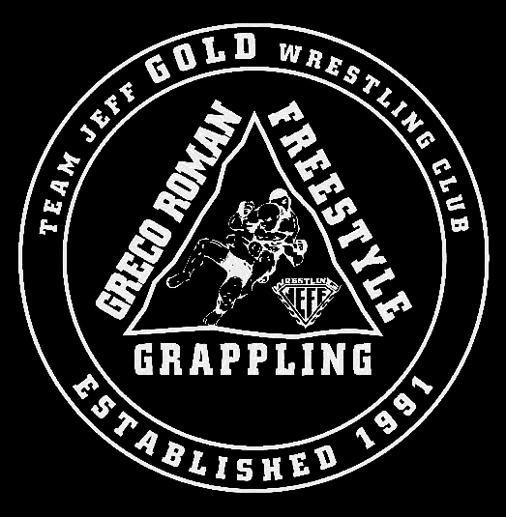
YOU THINK YOU WANT
Jeffersonville Red Devil Wrestling
TO TRAIN MMA????

Slide 2
YOU WANT TO TRAIN FOR THE UFC?
"I personally think that the very best skill for MMA is wrestling, I think that’s the number one base to come from because those guys just flat out dictate where the fight takes place.
Joe Rogan – UFC Commentator
Fall 2010

Slide 3
Influence of Wrestling in the UFC
Each Title Belt has had an NCAA Wrestler holding the belt
6 of the top ten HWTS wrestled in college
6 of the top ten L-HWTS wrestled in college
7 of the top ten welterweights wrestled in college
8 of the top ten lightweights wrestled in college

Slide 4
WRESTLING TO MMA= SUCCESS!!
2x Junior C. National Champ
State Champion
NCAA National Champion
WWE Champion
Former UFC Champion
-Brock Lesner
USA Wrestling Junior Freestyle Champion
NCAA All- American
UFC Champion
-Cain Valazquez

Slide 5
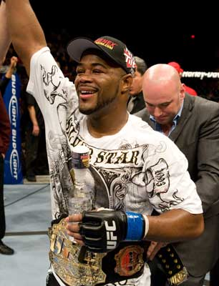
WRESTLING TO MMA= SUCCESS!!
High School Wrestler
College Wrestler
Former UFC Champion
-Rampage Jackson
NCAA All-American
High School State Champion
Former UFC Champion
-Rashad Evans

Slide 6
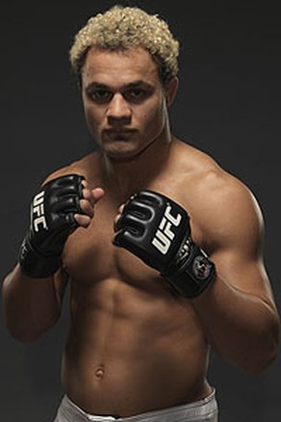
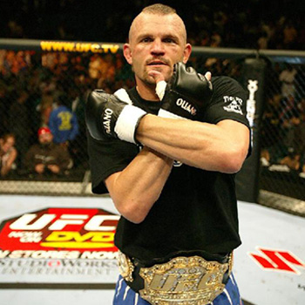
WRESTLING TO MMA= SUCCESS!!
High School State Champion
NCAA Champion
UFC TITLE CONTENDER
-Josh Koscheck
NCAA All-American
High School State Champion
Former UFC Champion
-Chuck Liddell

Slide 7
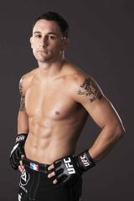
WRESTLING TO MMA= SUCCESS!!
High School State Champion
NCAA All-American
UFC CHAMPION
-Franky Edgar
NCAA All-American
High School State champion
Olympic Team Alternate
-Randy Coture

Slide 8
MMA Pros With Wrestling Background
Mark Kerr– MMA Athlete WRESTLER
1998/99 #1 MMA HWT in the world 1992 NCAA Champion
14-6 MMA Record
Defeated Randy Couture for his UFC Title
Mike VanArsdale– MMA Athlete WRESTLER
5-4 in MMMA 1998 NCAA Champion
Fought Couture and Vanderlei Silva Wrestled for Iowa State
Coaches Rashaad Evans Wrestled for the Army
Rex Homan- MMA Athlete WRESTLER
4-2 in MMA NCAA Champion for Ohio State
0-1 in UFC – only loss is to Matt Hamil – a 3x NCAA Champion

Slide 9
Some of the Big Names
Dan Henderson 2x Olympian Pride Champion | Jon Fitch Purdue Wrestler UFC Title Contendar | Diego Sanchez New Mexico State Champ UFC Fighter | Clay Guida Wrestler UFC Figher | Keith Jardine Wrestler UFC Title contender | Roger Huerta Wrestler UFC Title Contendar
Jake O’Brien 3x State Champ UFC Fighter | Chris Lytle State Runner up UFC Fighter | Brandon Vera Wrestler UFC Fighter | Gray Maynard Wrestler UFC Title Conteder | Corey Hill Wrestler MMA Athlete | Matt Grice Wrestler MMA Athlete
Karam Gaber Ibrahim Olympic Champ MMA Athlete | Royce Alger 2x NCAA Champ UFC Fighter | Johnny Hendricks 2x NCAA Champ UFC Fighter | Jake Sheilds Wrestler Strikeforce Champion | Matt Linland Olympic Medalist MMA Athlete | Sam Henson Olympian MMA Coach
Kenny Monday Olympic Gold Medalist – MMA Athlete | Mark Munoz 3x NCAA Champion MMA Athlete | Jake Rosholt 3x NCAA Champ MMA Athlete | Ben Askren 3x NCAA Champ Bellator Champ | Joe Warren Greco World Champion Bellator Champ | Daniel Cormier Olympian MMA Athlete

Slide 10
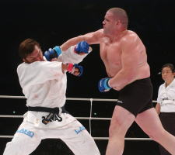
Olympic Gold Medalists
Rulon Gardner, the superheavyweight Greco-Roman gold medalist in the 2000 Olympics who retired as an amateur after capturing a bronze medal in 2004 battled, Hidehiko Yoshida, who had won a gold medal in judo, and years later, became a famous MMA star for the Pride Fighting Championships.
It's a routine Japanese promotional trick to take Olympic medalists out of their sport, and put them in with Japanese favorites, who have experience in MMA fighting. The idea was that Gardner would get Yoshida to the ground, but with no knowledge of submissions, he would then get submitted.It was an ugly fight because Gardner was no boxer, but, he battered Yoshida and took a unanimous decision. Gardner never fought again.

Slide 11
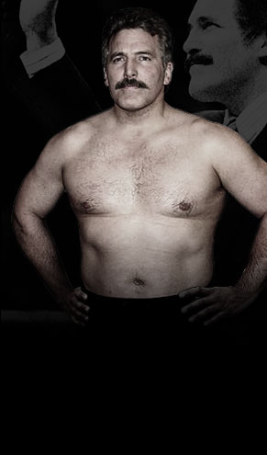
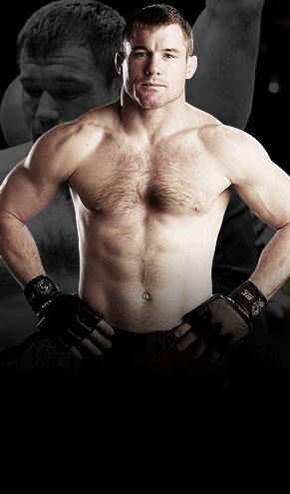
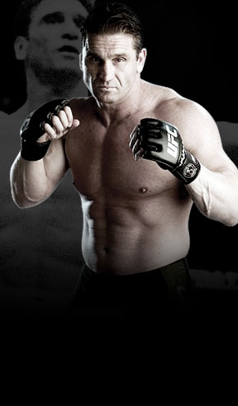
Hall Of Famers Who Wrestled
Mark Coleman
Dan Severn
Randy Couture
Matt Hughes
Chuck Liddell
Ken Shamrock
A decade from now will you be inducted as a member Jeff High Hall of Fame?

Slide 12
More UFC CHAMPIONS Who Wrestled
Tito Ortiz
Sean Sherk
Kevin Randleman
Josh Barnett

Slide 13
Crossover Skills
Many of the positions and skills are absolutely transferable between both sports
Some of those skills include but are not limited to footwork, hand-eye coordination, mental toughness, explosive movements, and balance
Learning the ability to pummel, perform takedowns, standups, and how to make weight are undeniable!
“I think you’re going to have to have a very good wrestling base.”
Dana White - UFC

Slide 14
Crossover Skills

Slide 15
Crossover Skills

Slide 16
Crossover Skills

Slide 17
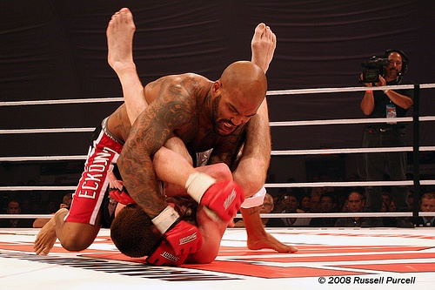
Crossover Skills

Slide 18
MMA+Wrestling=Success X 2
"I felt like I needed to bring [wrestling] back after the Machida fight," said Evans, who posted back-to-back knockout wins over Chuck Liddell and Forrest Griffin before the loss to Machida. "One thing that happens sometimes when you find success in one area – and I found success standing up – I kind of forgot about the area where I was strongest." Evans said his return to wrestling is part of his win-first mentality. "Me doing wrestling now is just going to be something I do from here on out," he said. "Because no matter how far (I get) in my stand-up, I've always got to remember that my bread and butter is my wrestling, and everything else stems from that."
-Rashaad Evans – former UFC Champion

Slide 19
Football+Wrestling=Success X 2
“Wrestling in my opinion is still the greatest sport there is because of the one-on-one nature of it,” Ray said. “There is no other sport that is as hand-to-hand, all combat as wrestling.”
Curtis Ray,
Former Arizona State Wrestler
Teammate to 4 UFC wrestlers

Slide 20
A Look at our recent MMA Athletes
Dominique Smith – Jeff High Grad ‘09 – HHC Champ – 2-1 in MMA
Wes Koch – Jeff High ‘99 – State Qualifier’s – MMA Fighter
Jimmy Wright – Jeff High ’04 – Conference Champ – MMA Athlete
Coach Maddox – college wrestler, proffessional football, undefeated in boxing and MMA!
Josh Stith – ’99 grad – 2x SQ undefeated MMA athlete

Slide 21
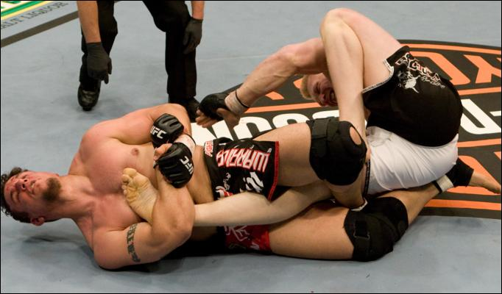
Stance, Motion, Level Change, Penetration Step
Jeffersonville Strong Basics…
Three Months of Constant Improvement of
Fundamental Skills and Toughness Training!
FUNDAMENTALS EVERYDAY

Slide 22
GENERAL INFORMATION Practice begins Monday, November 2 You will receive all practice gear at that time You will need a pair of wrestling shoes Football players do not need a physical form Practice will begin at 2:45 everyday Practices will finish at approximately 5:00pm for our Development Team Every wrestler will wrestle competitions. No one sits the bench!
Jeffersonville Wrestling
Making Athlete’s Into Champions!

Slide 23
Come out – I promise 3 things will happen – 1) Better takedowns 2) Better throws 3) better top man work!
Jeffersonville Wrestling
THREE THINGS MAKING YOU A….
BETTER MMA ATHLETE!

Slide 24
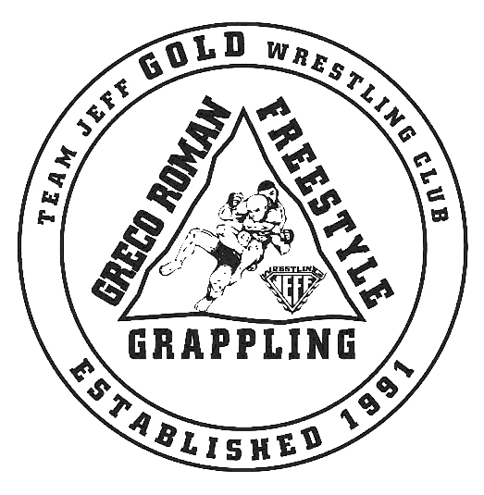
Join our GOLD CLUB, work with professional MMA fighers and receive this t-shirt:
Jeffersonville Wrestling

